Slide 1
Research Presentation
Gloria Jackson

Slide 2
Research Question
Based on what methods you use to determine the ancestral allele, what results do you get?
Notes:
this process of determining which allele is ancestral and which is derived is called “polarization”
Results as in, what does the deleterious burden look like? Is it higher in the domesticated population? The wild type? Usually, the domesticated has higher deleterious load than wild populations because population bottlenecks and small population sizes reduce the efficiency of purifying selection, allowing harmful mutations to persist. This idea is called “the domestication-cost hypothesis”

Slide 3
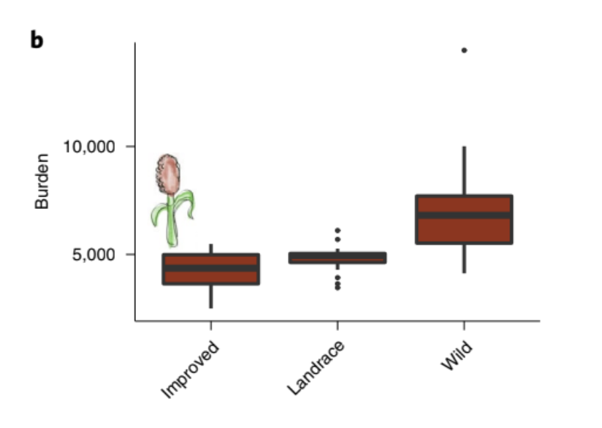
The Lozano Paper
https://doi.org/10.1038/s41477-020-00834-5
Notes:
This graph is from the Lozano paper, which was part of the summer 2025 project. It shows the deleterious burden calculated in improved aka domesticated sorghum, the traditional landrace variety, and the wild type.
They found that the deleterious burden was higher in the wild type, which deviates from the aforementioned domestication-cost hypothesis where the domesticated/improved population should have higher deleterious load. So basically what i did was try to replicate their results.

Slide 4
Polarization Methods
01.
Use outgroup as ancestral
02.
Lozano paper pipeline
Notes:
First just tried doing it the easy but effective way, which was to use the outgroup allele as the ancestral allele, and see if could replicate the lozano results that way

Slide 5
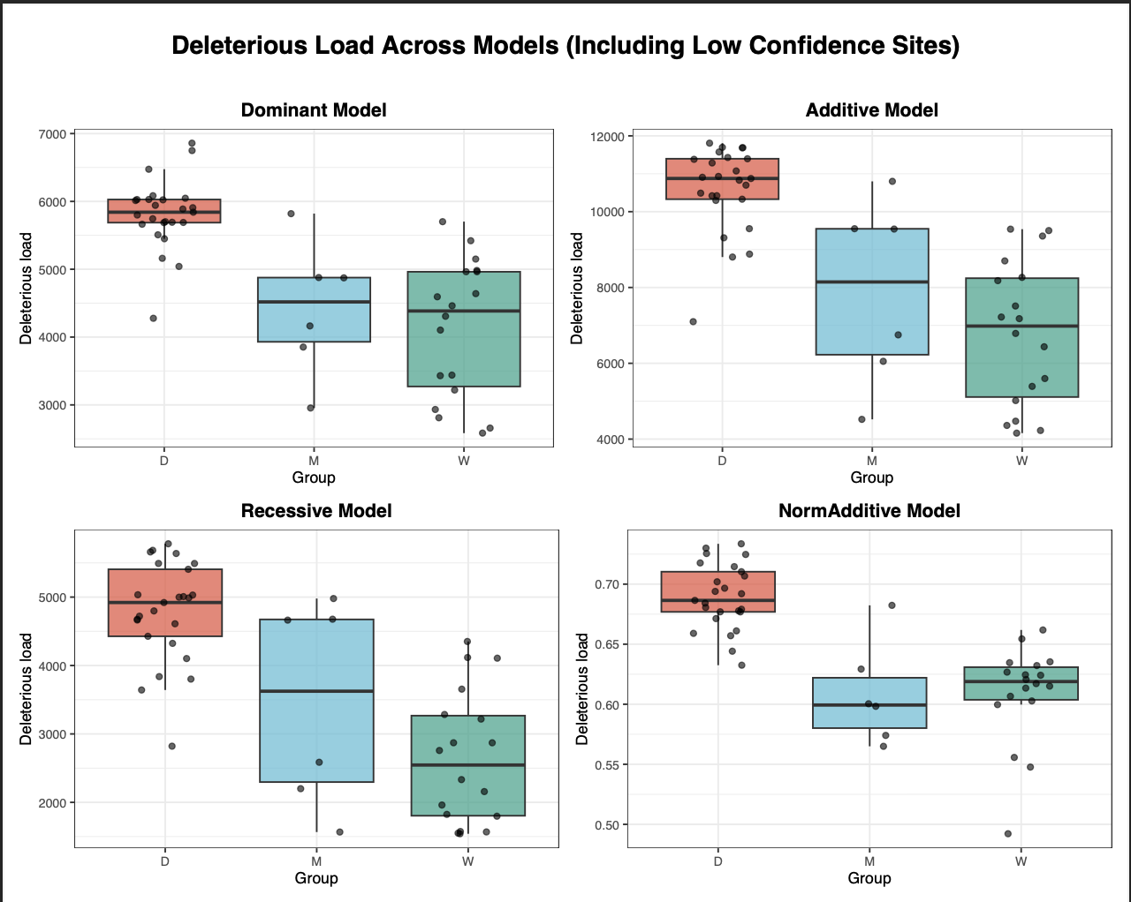
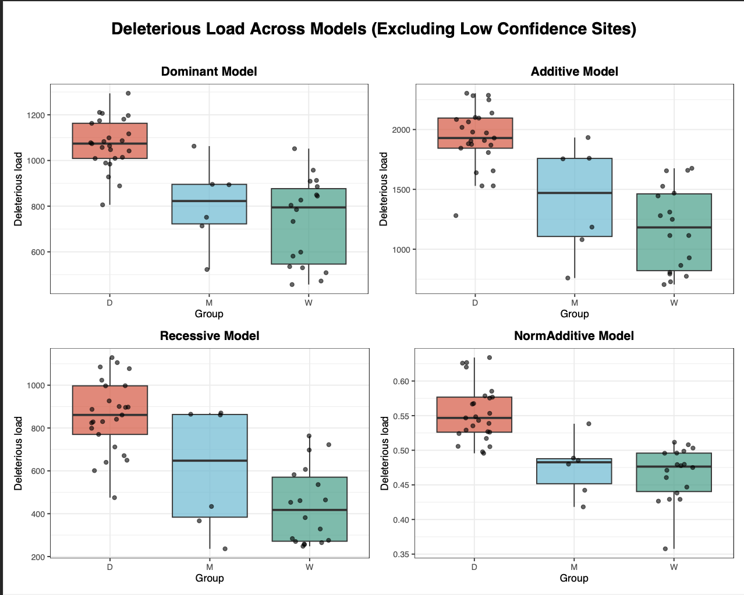
Using the outgroup as the ancestral allele
Notes:
These are my results from the summer 2025 project. Essentially the workflow was to take the filtered vcf file and run SIFT to find which SNPs are deleterious.
SIFT is a computational tool, stands for Sorting Intolerant from Tolerant and it basically predicts whether amino acid substitutions are deleterious, assigning scores where values below 0.05 indicate likely functional impact. it also flags the variants as “low confidence” when supporting sequence data is limited.
So basically i took the vcf with the SIFT scores and calculated the deleterious load under 4 different models (dominant, additive, recessive, and normalized additive) treating whatever allele the outgroup (S. propinquum) had as the ancestral allele.
Found higher del load in domesticated shown in red in the graph, which is not what the paper found. Even tried doing the calcs excluding those low confidence deleterious sites and got same thing: higher del load in the domesticated. So went back and did everything exactly the way its described in the paper
Model explanations just in case:
Dominant model: Counts the number of deleterious sites where an individual carries at least one derived deleterious allele (heterozygous or homozygous).
Recessive model: Counts the number of deleterious sites where an individual is homozygous for the derived deleterious allele.
Additive model: Counts the total number of derived deleterious alleles, assigning 1 for heterozygous and 2 for homozygous derived genotypes.
Normalized additive model: The additive count scaled by the number of non-missing deleterious sites for that individual.

Slide 6
Polarization Methods
01.
Use outgroup as ancestral
02.
Lozano paper pipeline
Notes:
So now we have moved on from doing it the simple yet effective way, and we are entering the world of Lozano
Place bets now! If i follow their methodology exactly, can i replicate their results?

Slide 7
The Lozano Paper Pipeline
01. Orthogroups
04. Mapping
02. Clustal Omega
05. est-sfs software
03. TranAlign
Notes:
Here we are: the Lozano paper pipeline
General overview–the main event is step 5. All the preceding steps are just required to get to the starting line that allows you to open the door, that then enables you to begin creating the input file that goes into that software. I will go thru each step shortly

Slide 8
Straightforward…or is it?
CSV/TSV files
CDS FASTAs
Nucleotide alignments
Text files
VCF files
GFF3 files
Protein alignments
Protein FASTAs
Notes:
Just want to take a moment to appreciate how unassuming the pipeline looks. The idea seems simple: just trying to determine which allele is ancestral using a focal species and outgroup species.
But the idea is complicated by all the different file formats, for example some being at the protein level and others being at the nucleotide level, as well as all the steps you have to take in between. And then you have to factor in the magnitude of working with thousands of files at the same time so it can be pretty daunting.
Nonetheless, we push onward! Or as the kids say, ‘we ball.”

Slide 9
Step 0: Organizing Data
Which files do I need?
Focal species: Sorghum bicolor (BTx623)
Protein FASTA
CDS FASTA
Gff3 file
VCF file
Outgroups: Setaria italica, Maize
Protein FASTAs
CDS FASTAs
Notes:
Before doing anything, we must define our focal species and our outgroup species.
I followed the paper’s methodology, which uses sorghum bicolor as the focal species, and for the outgroups they (and subsequently i) used setaria italica and maize which are also grass species like sorghum bicolor
For the focal species, you need its proteome and its reference genome, its gff3 file (which is, in short, a detailed annotation file that has all the exon coordinates, which strand the exon is on, some other features), and you also need the vcf file (the one we ran through SIFT that annotates which variants are deleterious)
For the outgroups, we just need their proteomes and their reference genomes

Slide 10
Step 0: Organizing Data
Deal Breakers
Protein FASTAs for each species→NO ASTERISK (TERMINAL CODON)
***SEQUENCE HEADERS MUST MATCH IN BOTH PROTEIN AND CDS FASTAS***
>Zm00001d033527_P001
>Zm00001d033527_T001
Trailing ‘.p’ → remove it!!!
Notes:
For protein fastas, ensure that the terminal codon ‘*’ is REMOVED
In protein and cds fastas, make sure that for each gene, the sequence names match!!!!!! Headers must match!!!! Headers!!! Must!!! Match!!!!!
So for example, the maize protein headers have the this ‘P’ suffix attached to the gene ID, and the maize cds headers have this ‘T’ suffix attached to the gene ID
And nobody mentions any of this, u just have to figure it out even tho its C R I T I C A L to the success of literally the entire pipeline

Slide 11

Step 1: Orthogroups
OrthoFinder
Focal species: Sorghum bicolor (BTx623)
Outgroups: Setaria italica, Maize
Protein Orthogroup FASTAs
CDS Orthogroup FASTAs
Notes:
Input the proteomes of these species into orthofinder to find their orthologues, which are genes that have been separated via speciation
Using the orthofinder output, for each orthogroup, make a protein fasta file containing the genes from the orthogroup. End result is a folder containing a protein fasta for each orthogroup, with each file including 3 sequences.
Do the same with the nucleotide sequences.
Take note of the order of the sequences!!! Sequence order must be the same in every fasta across every both folders→ every single cds and protein fasta has to have the 3 species formatted in exactly the same order. I chose: sorghum, maize, setaria
So every single file in both folders has the sorghum sequence first, then the maize sequence, then the setaria sequence
And the headers for each sequence match across both folders and the protein sequences have the asterisk (the terminal codon) removed

Slide 12
Step 2: Protein Orthogroup Alignments
Clustal Omega
Go through each protein orthogroup FASTA and align each one with Clustal Omega
Aligned Protein
Orthogroup FASTAs
Notes:
Next, we go through each protein orthogroup FASTA and align each file with Clustal Omega
The result is a new folder with the aligned protein orthogroup FASTAs

Slide 13
Step 3: Nucleotide Orthogroup Alignment
TranAlign
Part of the EMBOSS package
Requires an unaligned nucleotide fasta and an aligned protein fasta
Notes:
Uses the aligned protein fasta to align the nucleotides
so made a script that loops thru each fasta set (1 aligned protein fasta its corresponding cds fasta) and runs tranalign so i could get the output, which is a folder full of now aligned cds fastas

Slide 14
Step 3: Nucleotide Orthogroup Alignment
TranAlign
Aligned Protein
Orthogroup FASTAs
CDS Orthogroup FASTAs
Aligned CDS
Orthogroup FASTAs
Notes:
So to reiterate, tranalign takes this plus this and makes this
But you cant just input the whole folder, it only accepts files.
1 aligned protein FASTA and 1 unaligned CDS FASTA for the same gene
So i had to make a script that looped through the orthogroups in these folders and ran TranAlign 1 orthogroup at a time
Then i got the resulting aligned CDS orthogroup FASTAs

Slide 15
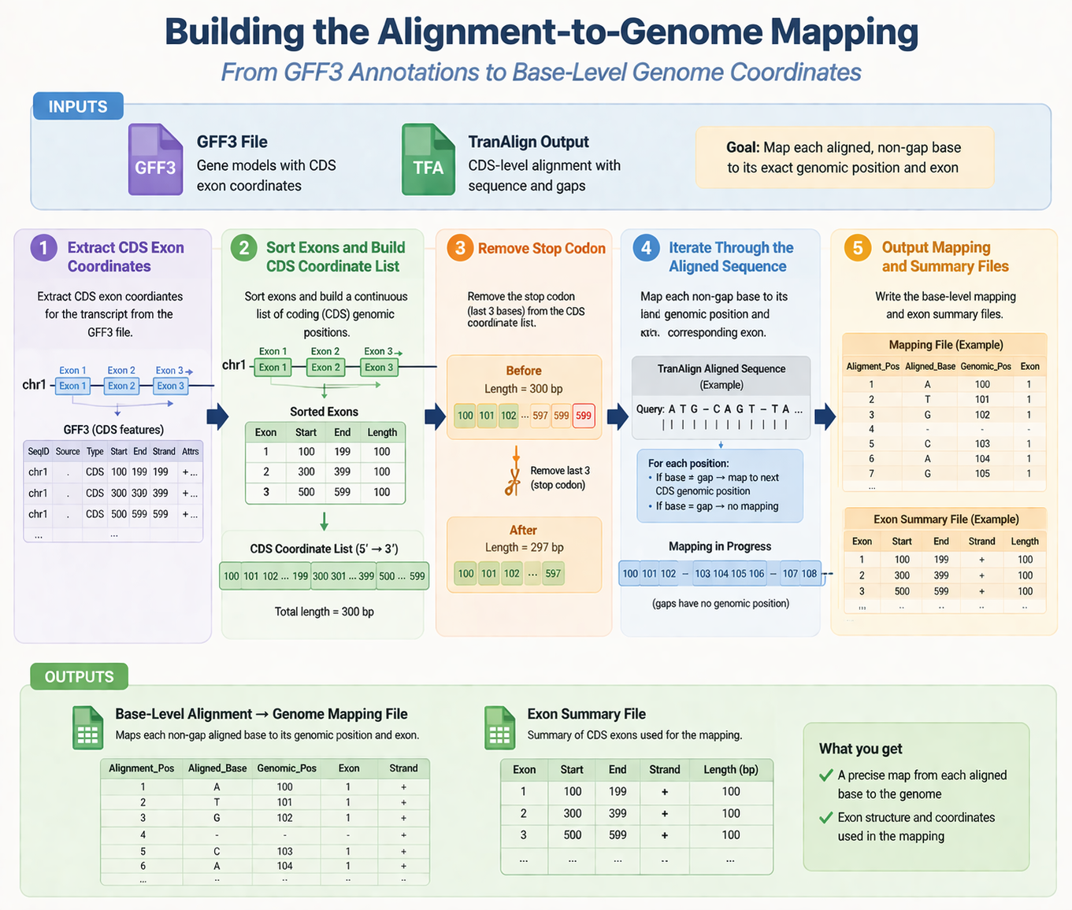
Step 4: Mapping
Translating alignment positions to their position in the genome
6
Notes:
Now we arrive at step 4, which is the most intensive step in the entire pipeline, and has been elegantly described in this flowchart via my prompts and ChatGPT
Goal: using the nucleotide alignment positions obtained from the tranalign output and the gff3 file of the focal species, map the nucleotide alignment positions to their genomic positions in the gff3 file; so we only do this for sorghum bicolor, our focal species
So what we need in order to accomplish this is the sorghum bicolor gff3 file, that annotation file that details the exon coordinates among other things, and the TranAlign output, which is our folder filled with aligned CDS FASTAs
We begin with the gff3 file, which the graphic has a little toy of example here, and extract the exons so we can get their start and end positions.
Note how we skip the introns because theres no coding sequence there, and we only care about the coding sequences
Next, we sort the exons and build a list of continuous of coding genomic positions
Again, note how the numbers skip a bit because we skipped the introns. So positions 200-299 would be an intron and consequently will be skipped
Next, we remove the last 3 bases because the gff3 file includes the stop codon but the aligned CDS FASTAs do not have the stop codon.
Then, we map each non-gap base to its genomic position and corresponding exon. We cant map the gaps because they have no genomic position, they are just part of the nucleotide alignment between the sorghum sequence and its maize and setaria orthologs
Go thru first few bases mapping
And then the outputs from this process are the actual mapping files for each sorghum bicolor gene in every orthogroup from the tranalign output that translate the alignment positions to their actual position in the genome, as well as a corresponding exon summary file that annotates how many exons the gene has, which strand its on, and the start and end positions of the exon

Slide 16
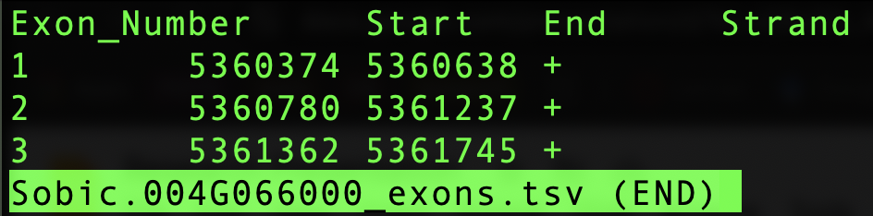
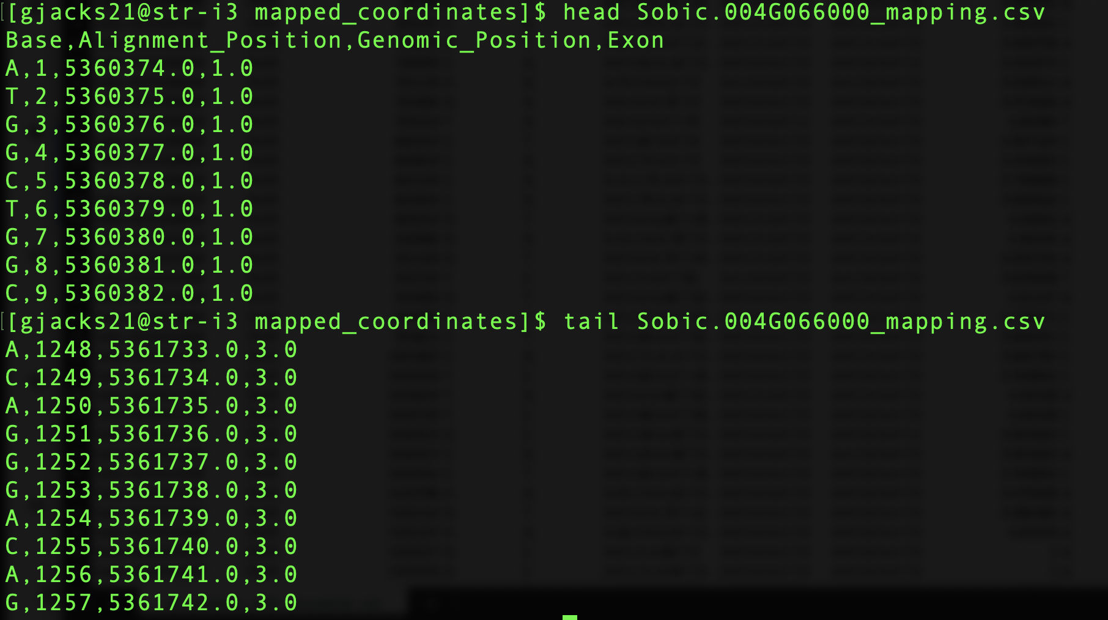
Step 4: Mapping
Plus Strand Example
Notes:
No more toy data; this is an actual exon summary file and the beginning and end of a mapping file for a sorghum bicolor gene on the plus strand
Since it is on the plus strand, we start at the starting position and as we perform the mapping process, the genomic position numbers should increase
Also, the exon summary was made using the exact data from the gff3 annotation file, which includes the stop codon.
since we subtract the last 3 bases in our script to account for the stop codon not being in the CDS sequences, our mapping file should have exactly 3 base pairs less than what the gff3 file has
So looking at the first few lines of the mapping file for this sorghum bicolor gene, we can see the base, the nucleotide alignment position that always increases because it just follows regular counting whether there’s a gap or not, we have the genomic position that increases because this gene is on the plus strand, and then we have a final column that tells us which exon the base belongs to
Looking at the last few lines of the mapping file, we can see the sequence ends at genomic position 5,361,742, which is 3 bp less than the gff3 because our CDS sequences have no stop codon and the gff3 file does, which is the desired outcome

Slide 17
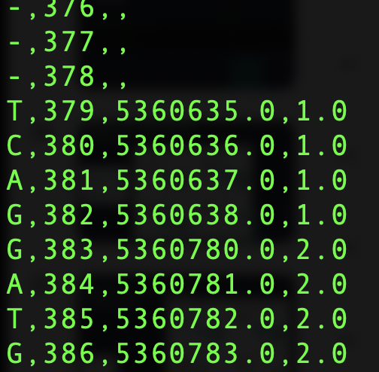
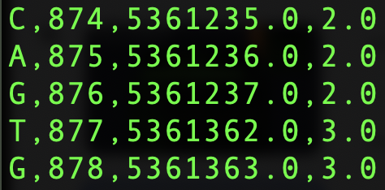
Step 4: Mapping
Plus Strand Example: Zooming in on Exons
Notes:
As i mentioned before, the introns are skipped. So any genomic position that is not in this continuous list of exons should not show up in the mapping file.
So for example, the first exon ends at position 5,360,638. There should be no 639 or 640 all the way up to 779 because the next exon begins at 5,360,780
*Pinpoint where jumps happen on exon summary file (zig-zag)
And we can see that happening in the mapping file, which conveniently annotates which exon the base of interest belongs to
This is also a good example of how as we go down the nucleotide alignment, even if there are gaps, the alignment position increases but the genomic position does not change because the gaps dont exist in the actual genome

Slide 18
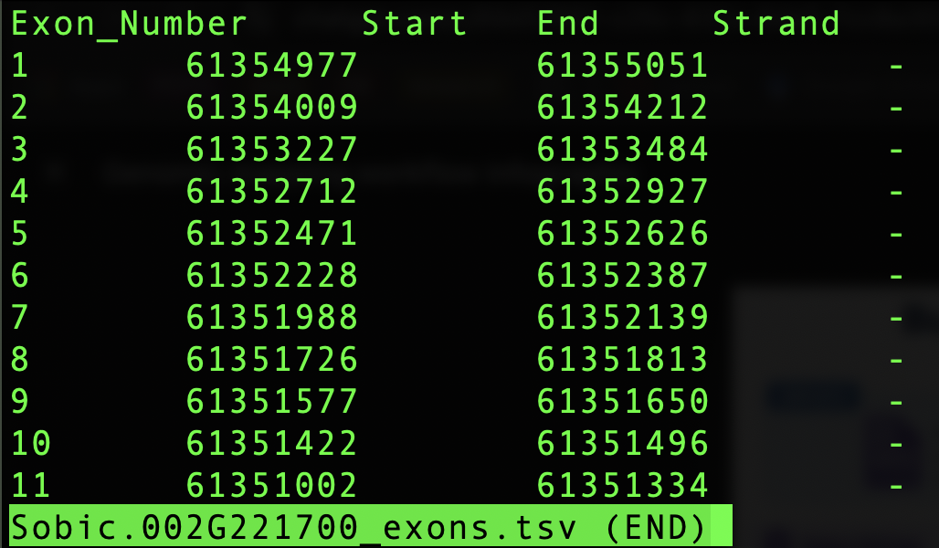
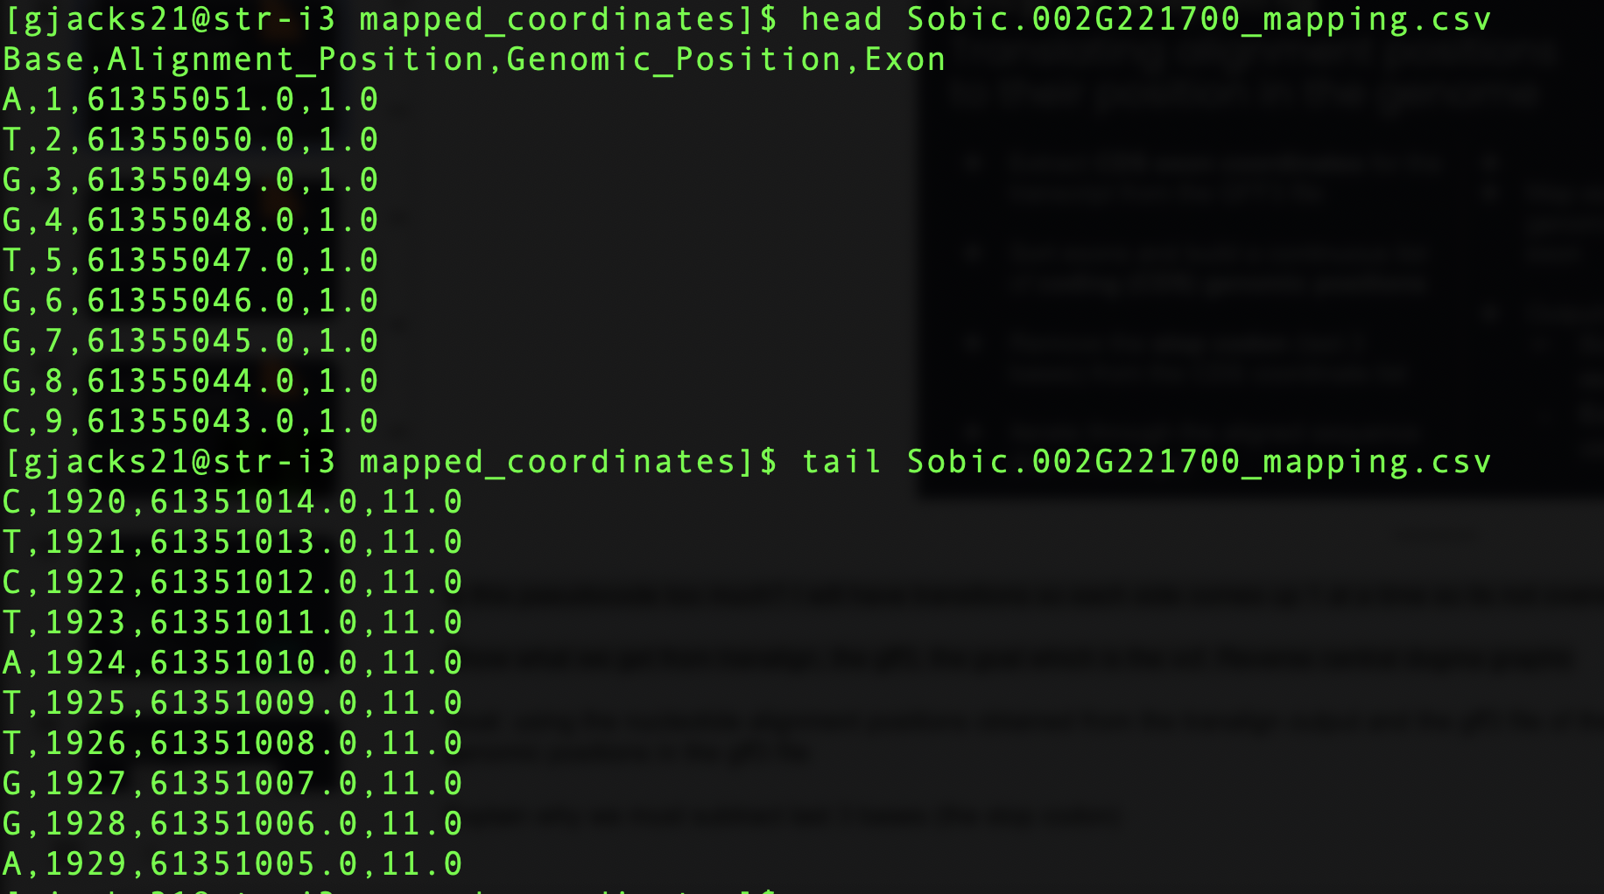
Step 4: Mapping
Minus Strand Example
Notes:
This is an example of an exon summary and mapping file for a gene on the minus strand. So since its on the minus strand our mapping file should actually begin at the end position of the exon and count down towards the start
We can see in the mapping file, it follows this trend
And since we are on the minus strand and we are basically counting backwards, our final genomic position should be 3bp ‘more’ than our gff3 file because its basically the opposite of what the plus strand would look like to account for that stop codon
So here the genomic position in the gff3 file ends at 61,351,002, so our mapping file should end with genomic position 61,351,005, which it does so that means we are doing well

Slide 19
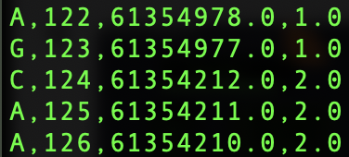
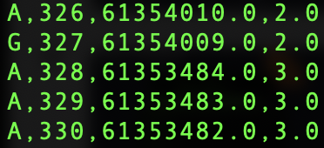
Step 4: Mapping
Minus Strand Example: Zooming in on Exons
Notes:
Same as with the plus strand, the introns are skipped but since we are on the minus strand when you look at the jumping scheme its more of a zag-zig instead of a zig-zag
Logic is still the same and its shown again in the mapping file where we go from the last genomic position in the first exon and skip all the positions in between (which would be the intron) and go right into the second exon
Same pattern when going from the 2nd exon to the 3rd

Slide 20
Step 5: The Big Kahuna
est-sfs software
Input files:
config-file.txt
seed-file.txt
data-file.txt
Notes:
We did all that…to make it to this moment: the est-sfs software
est-sfs is a program that estimates the unfolded site frequency spectrum (SFS) for a set of sequences and, in the process, infers the ancestral allele at each polymorphic site using allele frequencies and outgroup information. It provides a probability score for each ancestral state and flags low-confidence sites.

Slide 21
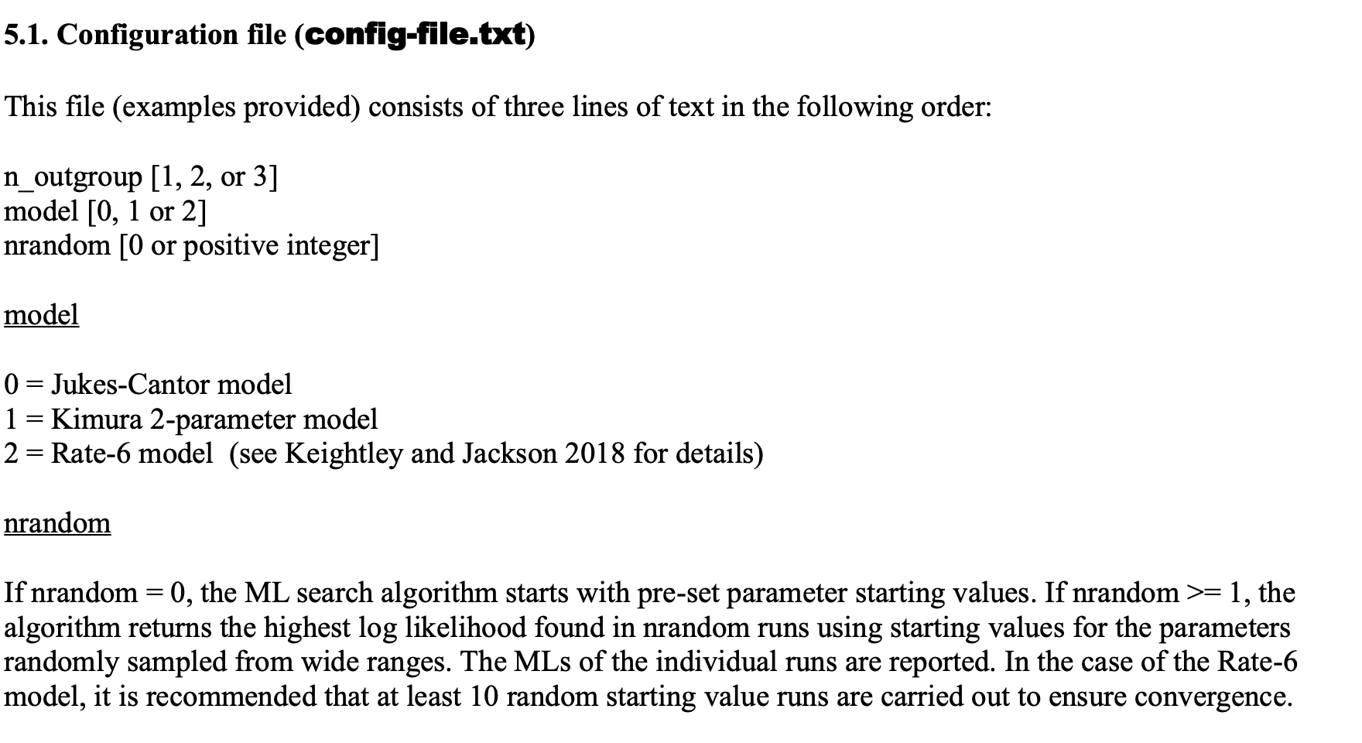
Step 5: est-sfs software
config-file.txt
Source: est-sfs software documentation
Notes:
This input file tells the program how many outgroups you’re using, the nucleotide substitution model to be implemented (you can choose from jukes-cantor, kimura 2-parameter, and the all rates different/rate-6 model), and then nrandom which is just a number thats 0 or a positive integer that the likelihood search algorithm starts out using

Slide 22
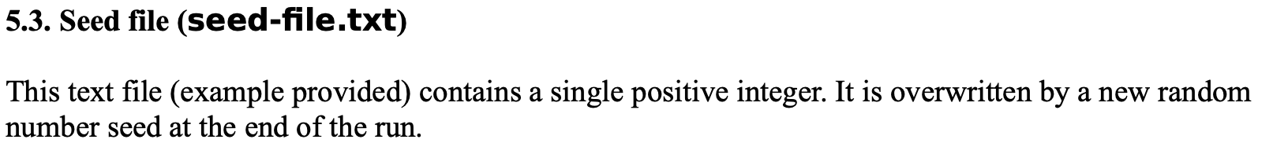
Step 5: est-sfs software
seed-file.txt
Source: est-sfs software documentation
Notes:
The seed file is just a positive integer. So literally just a text file with nothing else except for a single positive integer.

Slide 23
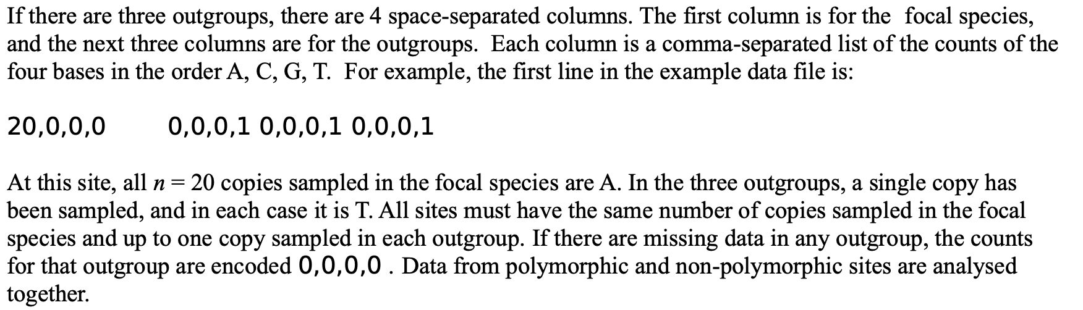
Step 5: est-sfs software
data-file.txt
Source: est-sfs software documentation
Notes:
This is the file we did all that prior work to create. So basically what we need is a file that has a bunch of rows that look like this
Each row represents a variant or a site in the vcf.
The first column represents the focal species, and the other columns represent the outgroup species. In our current case we would have 2 outgroup columns instead of 3 since we used 2 outgroups.
The columns hold a comma separating list of 4 numbers representing allele counts for the samples in the vcf file for that variant in the order of A, C, G, T.
So here at this site, they counted 20 ‘A’ alleles in the focal species, so there’s a 20 and a 0 for everything else. The outgroup columns all have a ‘1’ at the last position, with represents the ‘T’ allele. So all the outgroup species have the ‘T’ allele at that position.
If there are missing data in an outgroup, then the default is all zeros. I will explain how that can happen shortly.

Slide 24
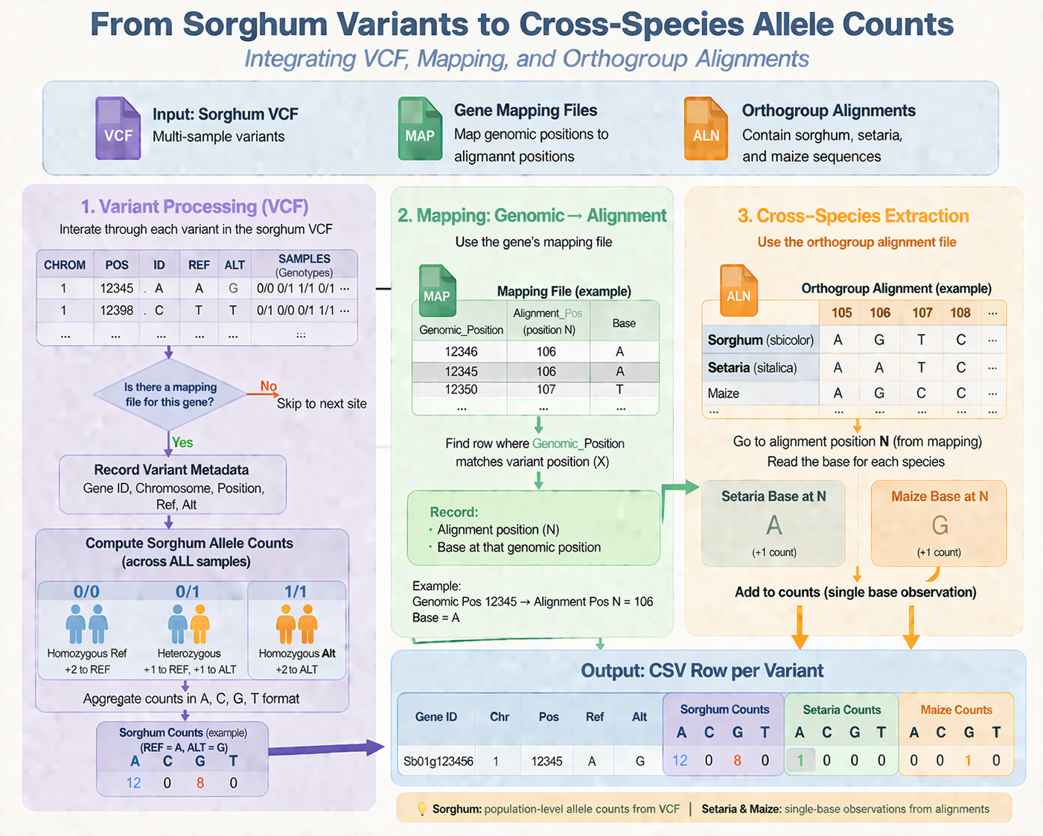
Step 5: est-sfs software
Generating data-file.txt
Iterate
Notes:
How do we make that file? This lovely AI-&-I generated graphic will walk us through how to get this done
So the files we need are the sorghum bicolor vcf that we ran SIFT on, the gene mapping files we just went through hell to create, and the nucleotide orthogroup alignments from the TranAlign step
First, we go thru the vcf and if we do NOT have a mapping file for that site then we skip it
If we do have a mapping file for it, then record the necessary metadata and do allele counts on allll the samples (50 samples)
So if the genotype is homozygous for the ref allele, we add 2 to the sorghum counts comma separated list corresponding to that allele because remember the positions in the list have meaning (A,C,G,T)
If the genotype is heterozygous, we add 1 to the ref allele and 1 to the alt allele
If the genotype is homozygous for the alt allele, we add a count of 2 to the alt allele
So looking at the first row in the toy vcf, assuming we have a mapping file for it, the ref allele is A and the alt allele is G
After parsing the genotypes of every sample, we count 12 of the ref alleles which is A so we put a 12 in the A position. And we count 8 of the alt alleles so we put an 8 in the G position of the comma separated list
Next, after taking note of the genomic position of the variant, we go to the mapping file for the gene the variant is in and we find the genomic position we saved from the vcf
So in this case the variant is at genomic position 12345, so we find that genomic position in our mapping file and obtain that genomic positions nucleotide alignment position→ also, a good sanity check here is to ensure that the base at the alignment position matches the reference allele in the vcf because it shows consistency since the vcf and the mapping files were created using the same reference genome for the focal species
But anyway, you record the alignment position N and the base at that position, then you go back to the folder with the nucleotide orthogroup alignment FASTAs
Find the file with the gene that the variant is in, then go to the alignment position N in the outgroup species and record the bases they have at that position by adding a count of 1 to the necessary position in that comma separated list for the outgroups
So here we go to alignment position 106 in setaria and maize because thats the alignment position that corresponds to the genomic position of the focal species variant, we see setaria has an A and maize has a G, so we add a count of 1 where it needs to go
Also, if at alignment position N for the outgroups there was a gap instead of a base, we would use the default comma separated list of all zeroes
In the end, we are left with a CSV file with the variant information and all the allele counts that we can condense so it looks like the data-file.txt the program requires

Slide 25
Step 5: The Big Kahuna
est-sfs software
Input files:
config-file.txt
seed-file.txt
data-file.txt
Output files
output-file-sfs.txt
output-file-pvalues.txt
Notes:
And then we also have the output files. The first one doesnt matter at all for our purposes, but it contains the estimated unfolded site frequency spectrum information
The file that really is important is the next file, which is the ancestral state probabilities output file. It has a lot of information, but the main feature of interest is the 3rd column which has the probability of the major allele being ancestral

Slide 26
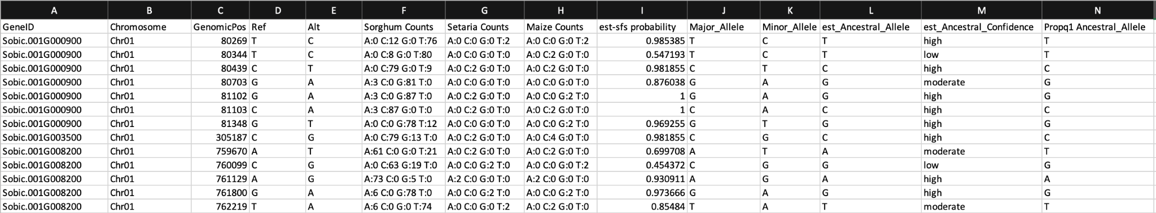
Step 5: est-sfs software
Le Results
Notes:
This is basically the CSV detailed file we made from the last graphic that is the precursor to the data file
And i extracted the 3rd column from that important output file and added it so i could make the ancestral allele calls
Go thru columns
Last column is the ancestral call made by just simply using the vcf file’s outgroup as the ancestral allele aka the EZ way

Slide 27
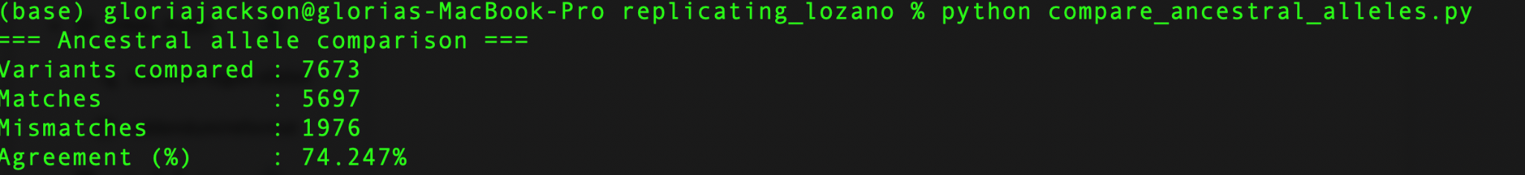
Step 5: est-sfs software
Le Results
Notes:
Ran this script to compare agreement between doing the pipeline the EZ way vs the lozano way and there was 74% agreement between the ancestral calls, which means approximately 3 times out of 4, u will make the same ancestral allele call if you just do it the EZ way

Slide 28
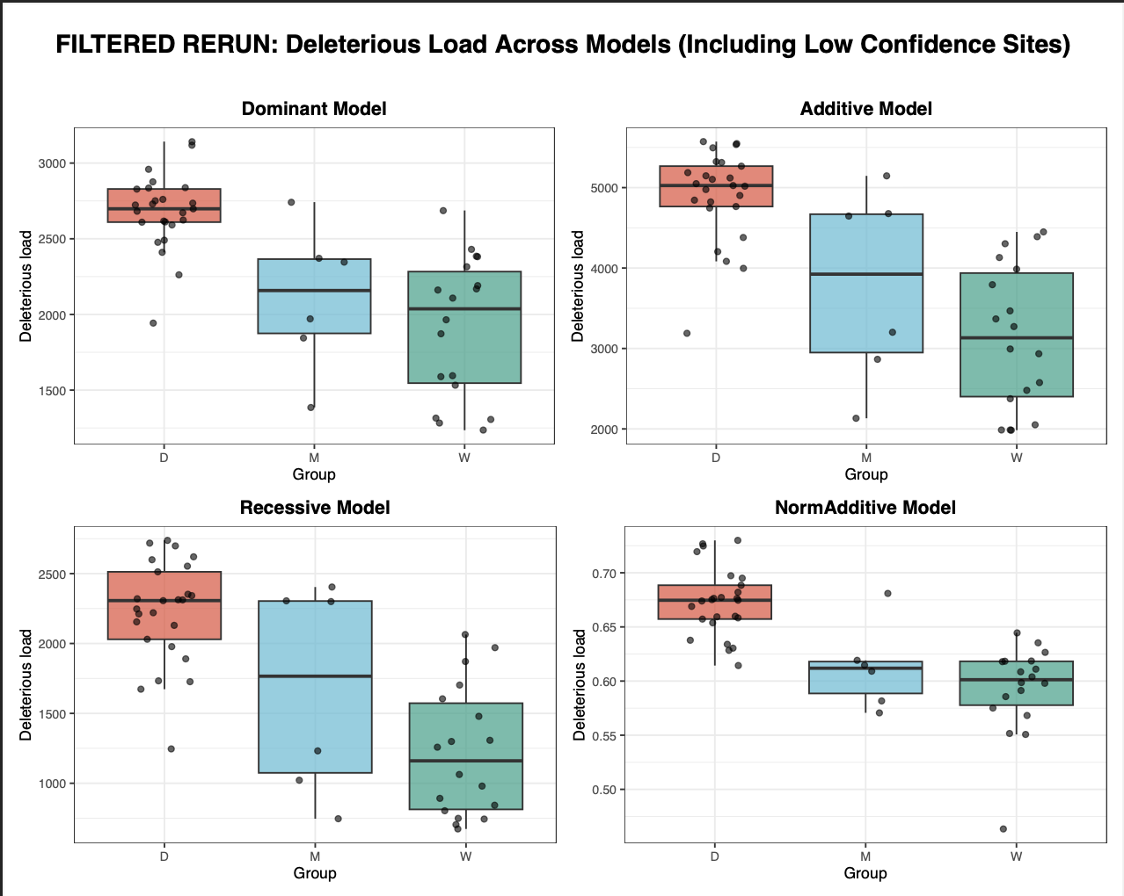
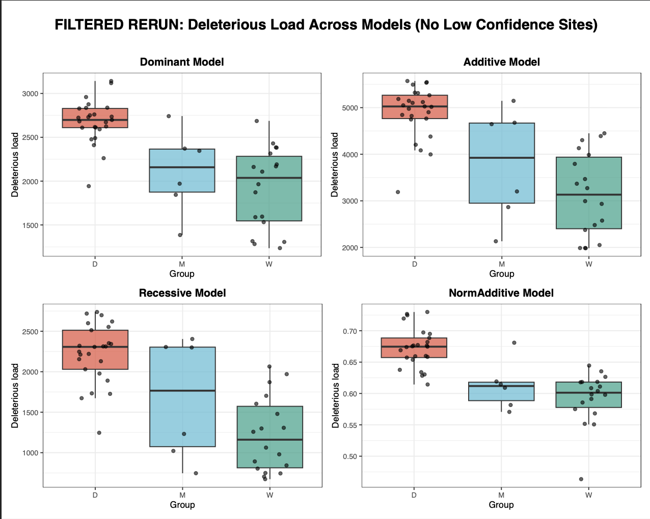
Step 5: est-sfs software
Le Results
Notes:
Filtered the deleterious vcf down to the sites used in this est-sfs software run and did the del load calcs again

Slide 29
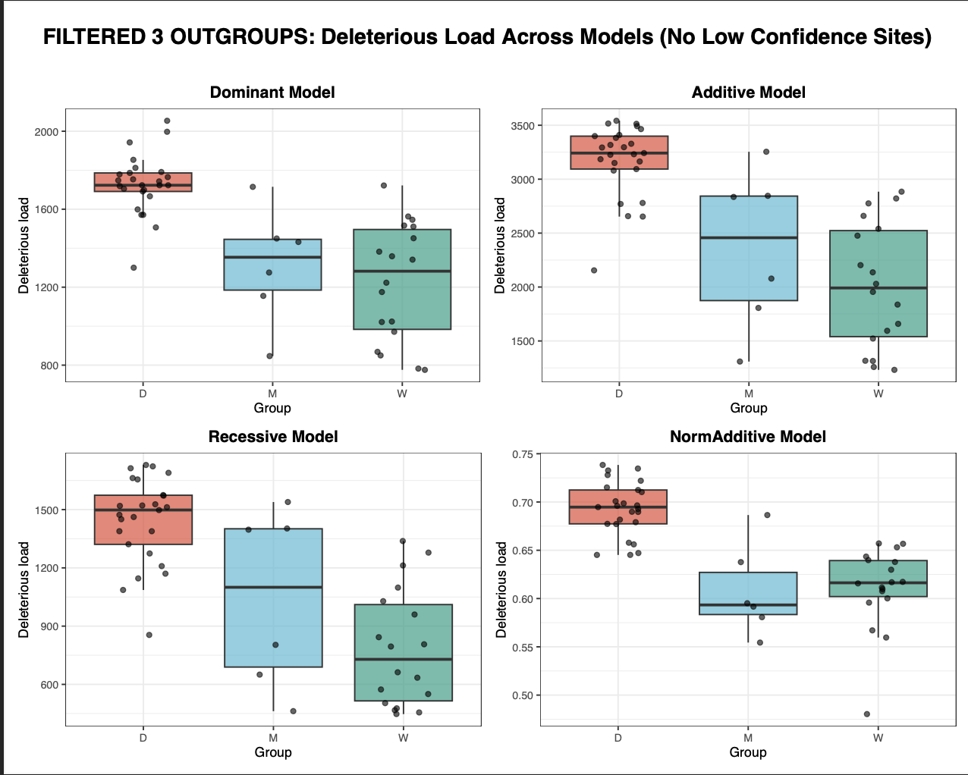
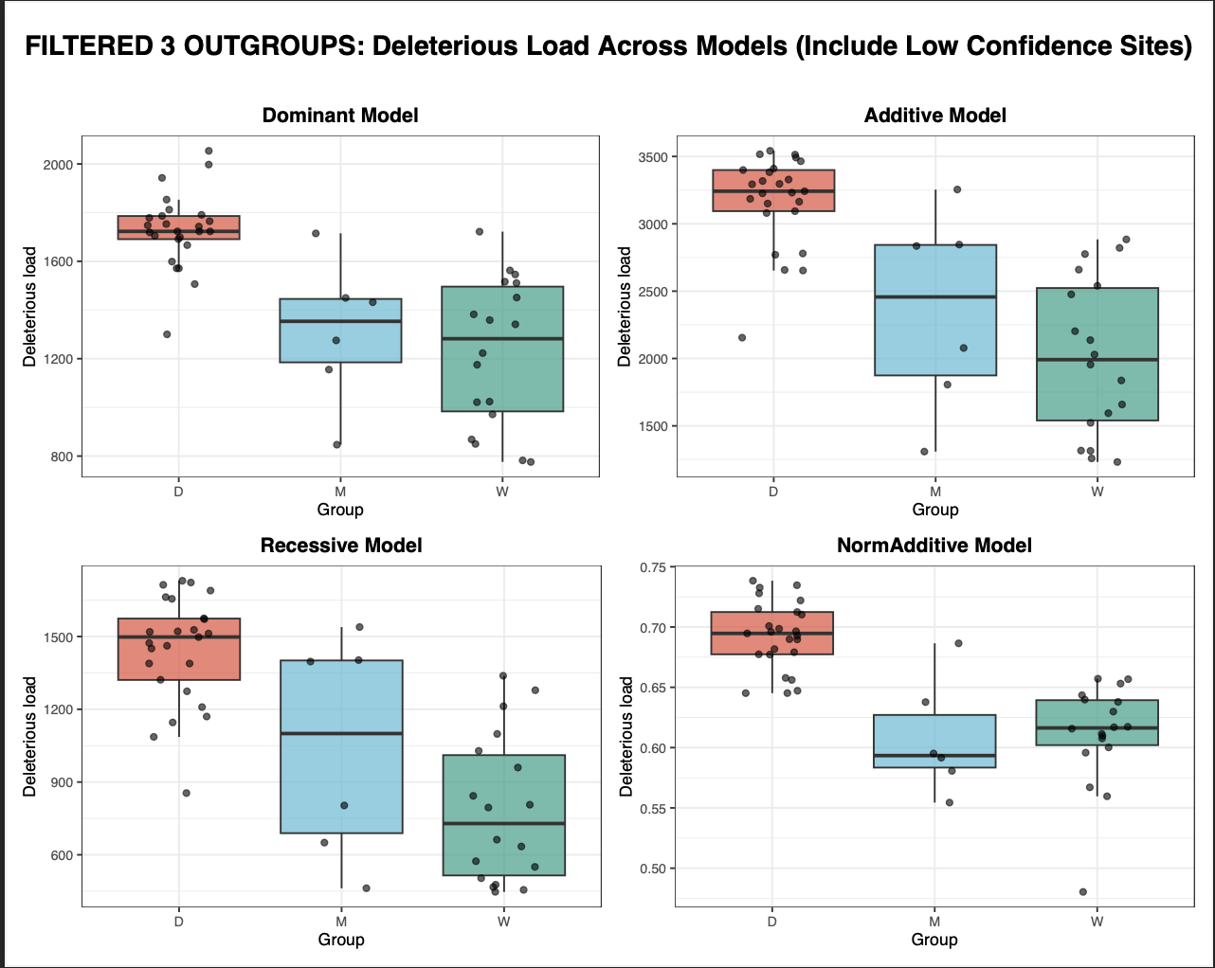
Step 5: est-sfs software
3 Outgroups
Notes:
Did the entire pipeline again but this time with 3 outgroups: setaria italica, maize, and sorghum propinquum

Slide 30
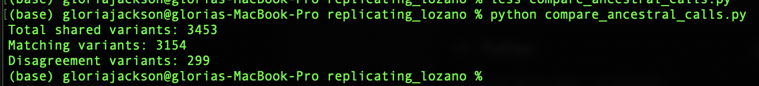
Step 5: est-sfs software
Comparing Results
Notes:
Next i made a script to compare the ancestral allele calls from my 2 outgroup vs my 3 outgroup est-sfs runs.
Basically these numbers tell us that there was a 91.3% agreement of ancestral calls between the 2 outgroup run and hte 3 outgroup run, so very similar results even if you increase the number of outgroups used
7673 variants in 2 outgroup run, 4807 variants total in 3 outgroup run
So 71.8% total shared variants (3453/4807)
Of those shared variants, 91.3% agreement of ancestral calls made by est-sfs

Slide 31
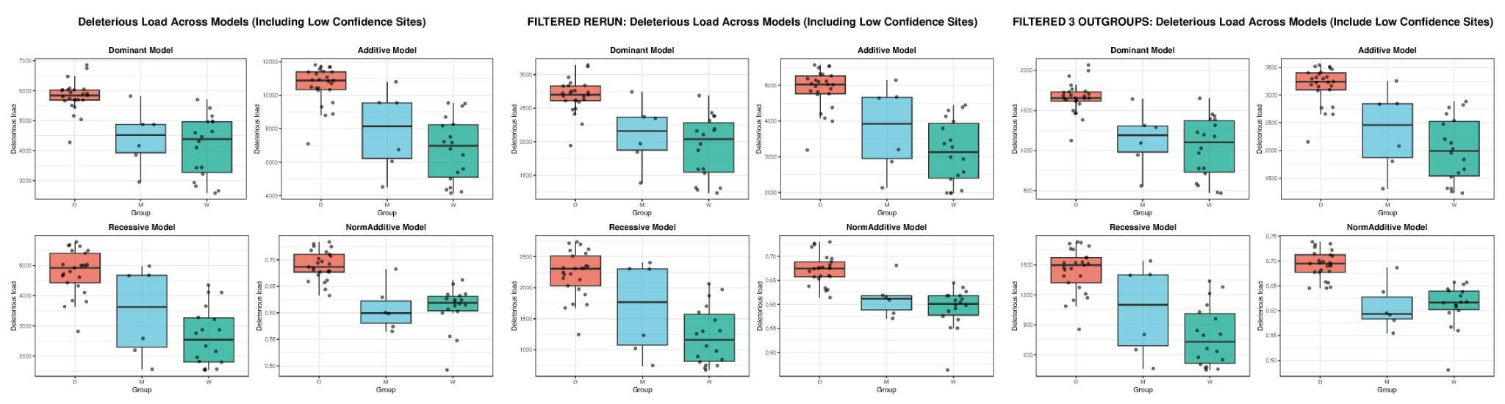
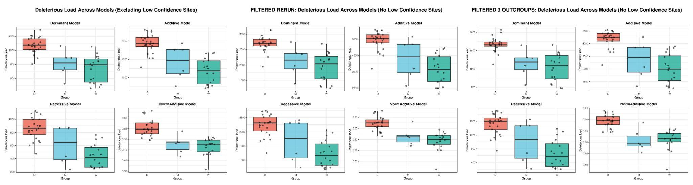
Put it all together now!
Notes:
No matter which way u work it out, domesticated consistently has higher deleterious burden. With low confidence, without low confidence, using est-sfs with 2 outgroups, using est-sfs with 3 outgroups, simply just using the outgroup as the ancestral allele, results are the same every. Single. Time. only diff is the # of available sites that can be used in final del load calcs bc with more outgroups the orthogroups are constrained a bit bc orthofinder must find shared genes between a higher number of species.

Slide 32

Takeaways
Went into this thinking polarization might have a big impact on results…it doesn’t
Deleterious load consistently higher in domesticated regardless of polarization method
Notes:
Because of the Lozano paper results, we went into this thinking polarization might have big impact on results. But turns out it doesnt have much impact.

Slide 33
Thank you :)

